Slide 1


PL/SQL wed grp on December 4TH 2024
Predictive Analytics for Disaster Management
This presentation explores the transformative potential of a predictive analytics system for disaster management, leveraging real-time data centralization and advanced modeling to enhance preparedness, response, and mitigation efforts.
MAYANJA Leon SENGENDO 26453
MUGABEKAZI Liliane 25505
IRIZA GATERA Merveille 26266
KUBWAYO Elyse Mireille 26490
Prepared by HAWKS Team members:
SANO Chris Armel 24699
SABOUR Yacoub Mahamat 24845
IRADUKUNDA Boris 25509
ISHIMWE Joyeuse 26756
NSENGIYUMVA Egide 24622
Ange Kimberly MUKESHIMANA 25580
NAMAHORO Sandrine Marie Merci 25423

Slide 2
1. PROBLEM STATEMENT
The Challenge: Global Disaster Impact
1
Disasters like hurricanes, floods, and earthquakes pose significant challenges globally, causing economic devastation, infrastructure damage, and loss of life. Recent examples include the October 9, 2024, Florida hurricane (with uncertain death tolls) and the April 16, 2024, Dubai floods. These events highlight a widespread issue: approximately 90% of countries experience natural disasters annually.
2
The Need: Real-Time Disaster Assessment
The urgent need for a real-time disaster assessment database is clear. This system would centralize vast amounts of data, improving forecasting, decision-making, and preparedness, thus reducing the impact on lives and economies.
Florida Hurricane (October 9, 2024): Category 3 hurricane resulting in significant losses and uncertain death tolls.
Project Objectives
3
Prediction and Forecasting
Dubai Floods (April 16, 2024): Caused substantial damage, reflecting a global problem affecting about 90% of countries.
Centralized Data Management
A comprehensive database is crucial to address these critical challenges.
Enhanced Preparedness and Response
Global Collaboration
4
Key Database Entities
Disaster: Disaster_ID (PK), Disaster_Type, Date, Magnitude, Location_ID (FK)
Location: Location_ID (PK), Country, State, City
Predictions: Prediction_ID (PK), Disaster_Type, Predicted_Date, Risk_Level, Predicted_Location_ID (FK), Prediction_Method
Weather Conditions: Condition_ID (PK), Location_ID (FK), Temperature, Rainfall
PreparednessMeasures: Measure_ID (PK), Disaster_ID (FK), Measure_Description, Measure_Type, Start_Date, End_Date
Expected Outcome
5
This database will enable real-time data processing, data-driven decision-making, and more accurate disaster predictions through the integration of diverse data sources, improving risk assessment and preparedness.
HistoricalDisasterData: HistoricalData_ID (PK), Disaster_ID (FK), Location_ID (FK), Date, Impact_Level, Response_Time
Relationships: The database will establish relationships between these entities using foreign keys to link disasters to locations, weather conditions to locations, preparedness measures to disasters, and historical data and predictions to both disasters and locations.

Slide 3

Importance of Real-Time Data Centralization
Real-Time Insights
Improved Situational Awareness
Centralizing data from diverse sources like weather stations, sensor networks, and social media provides a comprehensive view of disaster events in real-time.
This centralized data allows for accurate and timely understanding of the unfolding situation, enabling better informed decision-making.
Efficient Resource Allocation
Real-time data empowers emergency responders to effectively allocate resources, prioritizing areas with the most pressing needs.

Slide 4
Introduction to Disaster Management Challenges
Predicting the Unpredictable
Limited Resources
Rapid Response Time
Natural disasters are unpredictable events that can cause widespread damage and loss of life. These events pose a significant challenge to communities, governments, and emergency responders.
Emergency services often face limitations in resources, manpower, and equipment during disaster events. This can hinder their ability to effectively respond to emergencies.
The timeliness of disaster response is crucial for saving lives and minimizing damage. Every second counts in disaster situations, where swift action is essential.

Slide 5
Leveraging Predictive Modeling
1. Pattern Recognition
1
Advanced algorithms analyze historical data to identify patterns and trends related to disaster events.
2
2. Risk Assessment
Predictive models help to identify areas at risk of disaster events and estimate the potential impact.
3. Early Warning Systems
3
These models enable the development of early warning systems, providing timely alerts to communities at risk.
4
4. Evacuation Planning
Predictive analytics aids in creating more effective evacuation plans, ensuring the safety of affected populations.

Slide 6





Key Features of the Database System
Real-Time Data Ingestion
Secure Data Storage
The system continuously collects data from various sources, ensuring rapid data ingestion and processing.
Robust security measures protect sensitive data, ensuring its integrity and availability.
Advanced Analytics Capabilities
Visualization and Reporting
The system provides advanced analytics capabilities for data exploration, pattern identification, and predictive modeling.
User-friendly interfaces and reports enable easy visualization and communication of insights.

Slide 7
Enhancing Decision-Making and Response Capabilities
Improved Situational Awareness
1
The system provides real-time updates on the evolving situation, enabling more informed decisions.
Optimized Resource Allocation
2
Predictive analytics helps to prioritize resources and allocate them to areas with the highest need.
Enhanced Coordination
3
The system facilitates efficient communication and coordination among emergency responders and government agencies.

Slide 8

Empowering Rescue Teams and Government Agencies
1
Informed Decision-Making
Rescue teams make informed decisions based on real-time data and predictive insights.
2
Targeted Search and Rescue
The system helps identify and locate those in need, directing rescue efforts effectively.
3
Optimized Evacuation Routes
Predictive models aid in creating efficient evacuation routes, ensuring the safety of those affected.
4
Improved Disaster Preparedness
The system supports proactive planning and preparedness, minimizing disaster impact.

Slide 9
Developing a Robust Database for Predictive Disaster Management
This project focuses on creating a high-performance database management system to support real-time predictive analytics for disaster response. The system must automate data workflows from diverse sources (sensors, social media, etc.), ensuring data consistency and security. Advanced database programming is crucial for handling large datasets, processing complex queries efficiently (e.g., identifying at-risk areas, predicting resource needs), and maintaining data accuracy with comprehensive auditing capabilities to support decision-making and accountability.

Slide 10
Enhancing Disaster Management with Advanced Database Programming
Triggers
Cursors
Functions
Automated responses to database events (data updates or insertions) ensure immediate critical actions. A trigger could automatically notify emergency responders when a new disaster alert is recorded.
Enable sequential processing of query results, crucial for large datasets. They allow for efficient handling of complex data manipulations and analyses, such as iterating through real-time sensor data.
Custom functions encapsulate complex data processing logic, like calculating risk levels based on various parameters (weather, historical data). This modular approach enhances code reusability.
Packages
Auditing Techniques
Grouping related functions and procedures streamlines development and improves performance. Packages organize disaster-related functionalities for easier management and updates.
Recording all transactions provides accountability and analysis. This is vital for assessing response effectiveness and refining future strategies

Slide 11




TOOLS AND TECHNOLOGIES
GitHub :Serves as the project repository for PREDICTIVE ANALYTICS ON COMPLEX SYSTEM (our project) it helps us to collaborate ,issue tracking and also code reviews which helps us to manage changes and facilitating team work.
2.SQL developer: it helps us to facilitate writing and testing SQL and PL/SQL scripts, it enhances productivity by providing features such as syntax highlighting, code completion, and easy debugging tools.
3.SQL Plus: it allows us to execute SQL scripts efficiently, it helps in editing scripts by using Edit command ,and also helps in error handling
4.PL/SQL Programming language: PL/SQL allows us to write complex database applications by integrating SQL with procedural programming. it supports the creation of reusable code blocks such as procedures, functions, and packages. This modularity promotes code reusability and easier maintenance. provides robust error handling through exception blocks, allowing us to manage runtime errors.

Slide 12
STEPS FOLLOWED IN PROJECT DEVELOPMENT
Step 1: Problem Statement and Presentation
1
We discussed the project, identified core issues, and ensured stakeholder understanding of requirements through thorough discussions.
2
Step 2: Business Process Modeling
We mapped out business processes impacted by the project, using flowcharts and diagrams to visualize workflows and identify areas for improvement.
Step 3: Logical Data Model Design
3
We developed a logical framework for the database architecture, defining entities, attributes, and relationships using ER diagrams to map one-to-many, many-to-one, etc.
4
Step 4: Creating and Naming Databases (Database Creation)
We executed the design by creating the actual database (tables) using SQL, ensuring compliance with the logical model.
Step 5: Table Implementation and Data Insertion
5
We defined and created tables based on the logical model and inserted sample data to test relationships and constraints.
6
Step 6: Interaction with the Database and Transactions
We performed database operations (inner join, outer join, cross join) and managed transactions (insert with commit and rollback on error).
Step 7: Advanced Database Programming and Auditing
7
We wrote PL/SQL scripts for triggers, stored procedures, and cursors to automate tasks and set up auditing mechanisms to log user activities and track system changes.

Slide 13
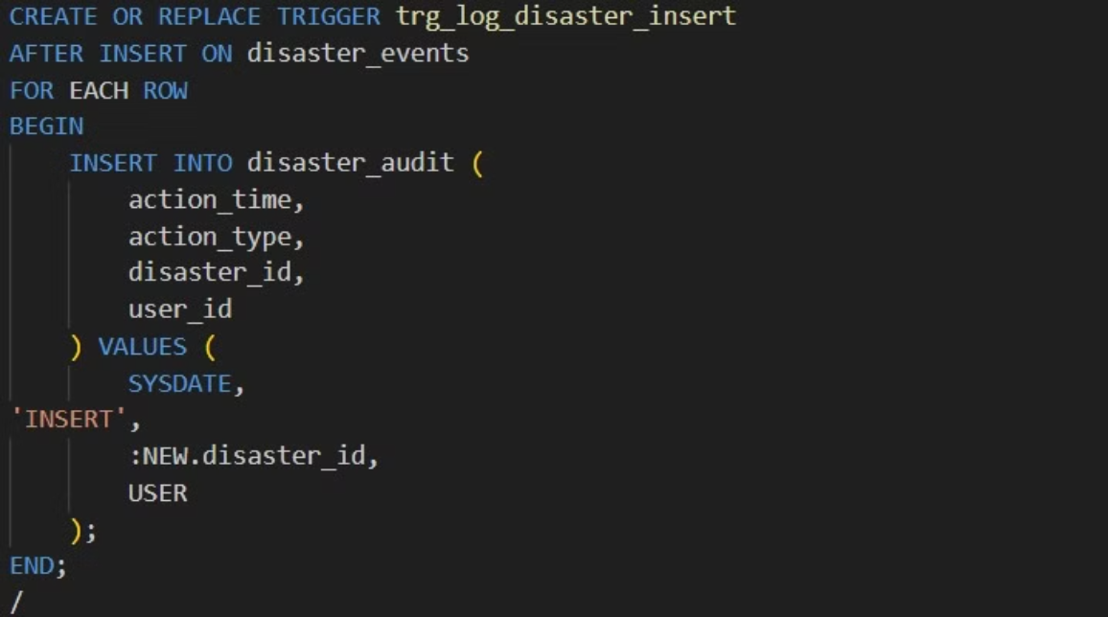
ADVANCED DATABASE PROGRAMMING in use
AFTER TRIGGER

Slide 14
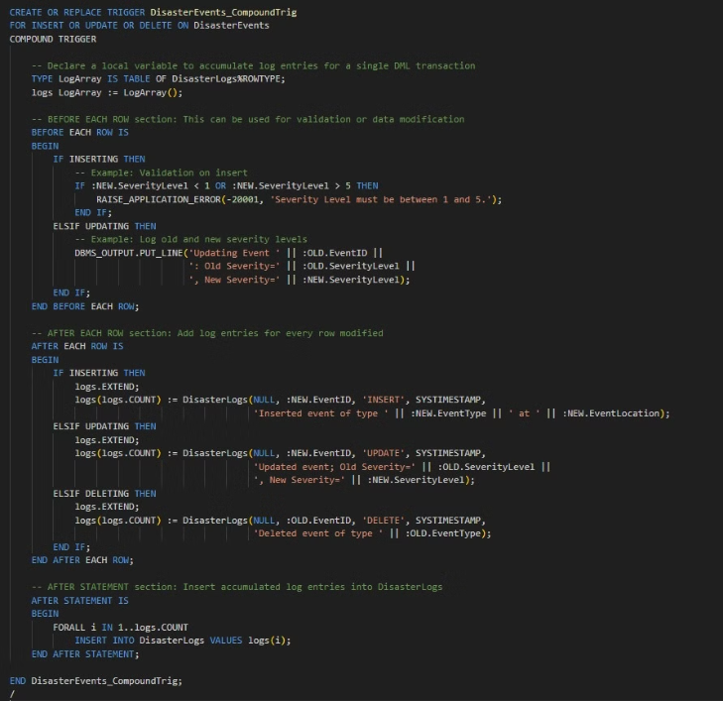
COMPOUND TRIGGERS

Slide 15
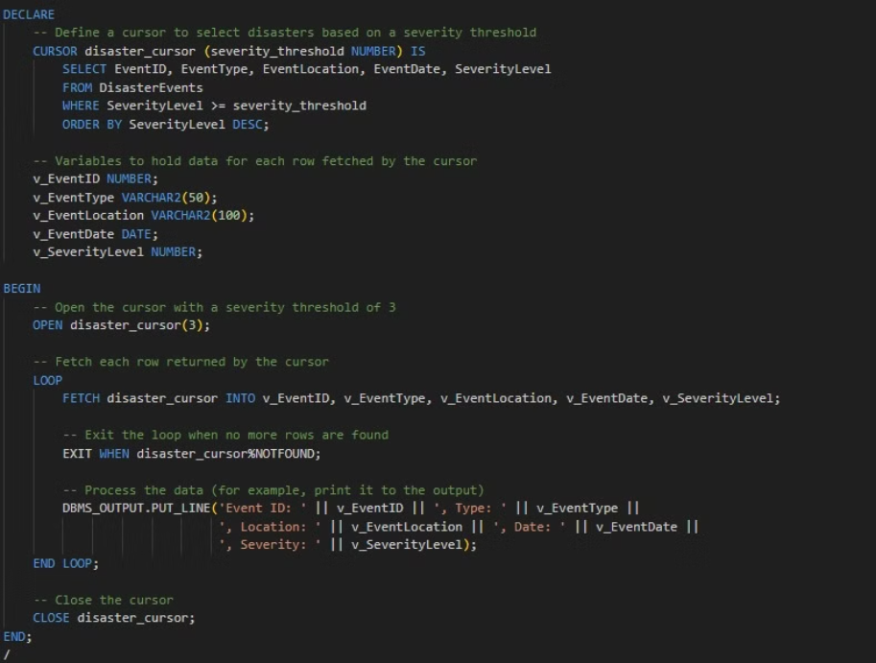
cursors

Slide 16
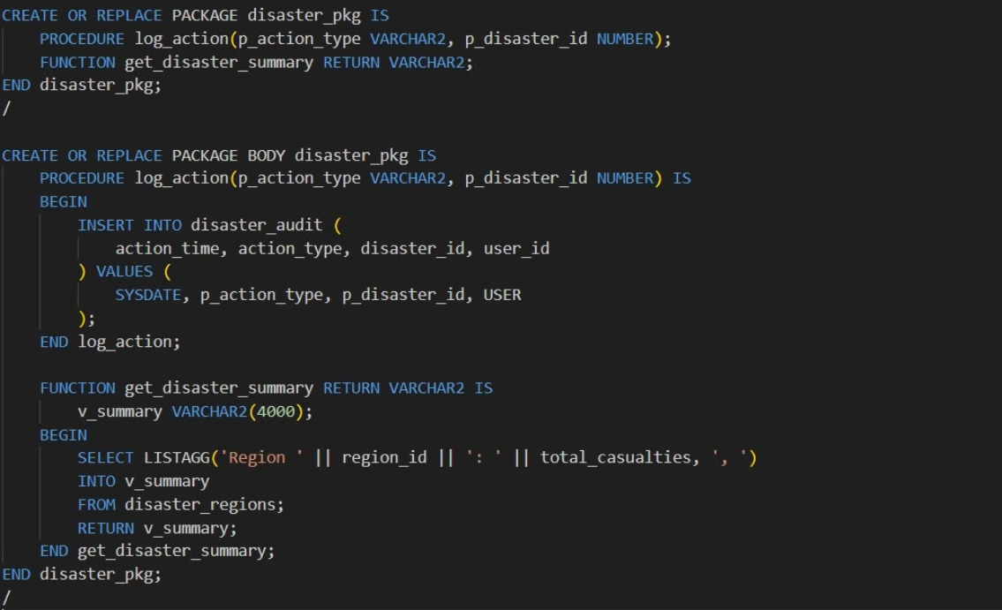
PACKAGES

Slide 17
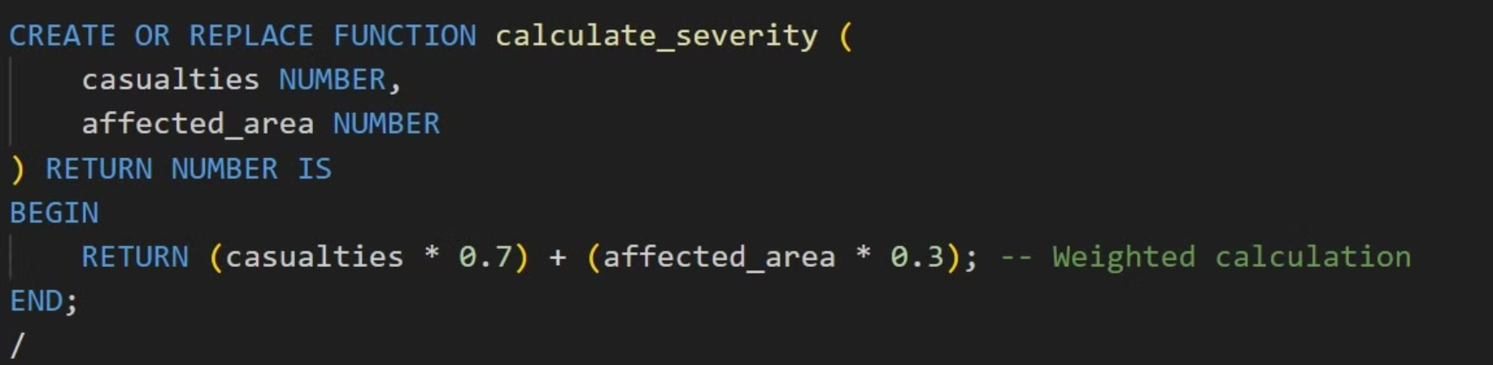
FUNCTION

Slide 18
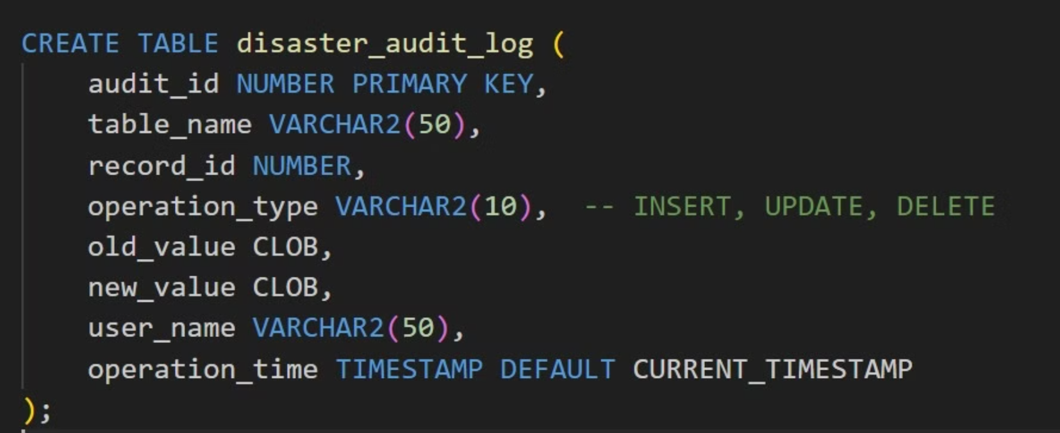
DISASTER AUDITING

Slide 19
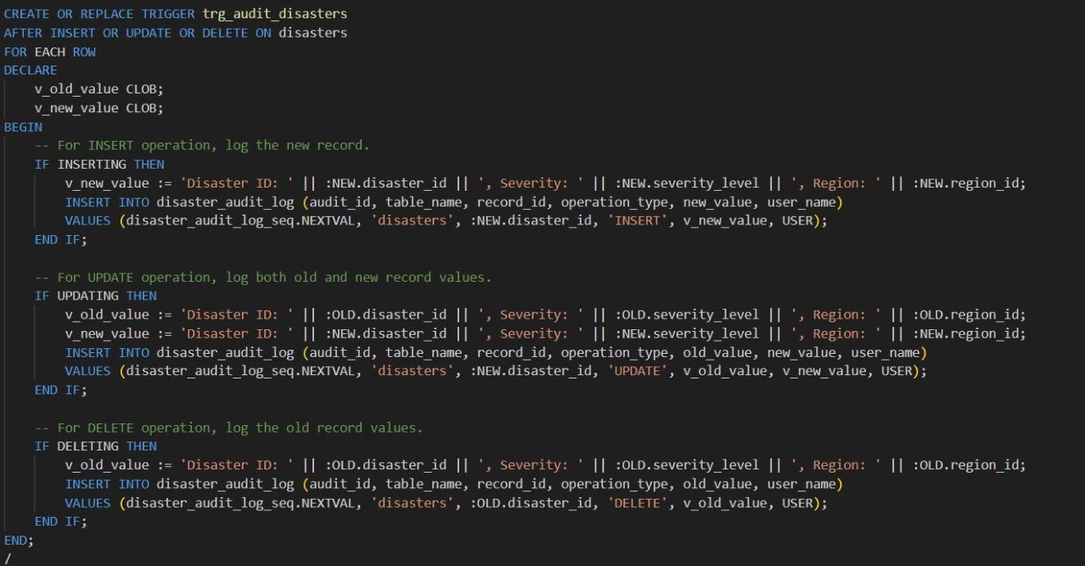
TRIGGER AUDITING

Slide 20
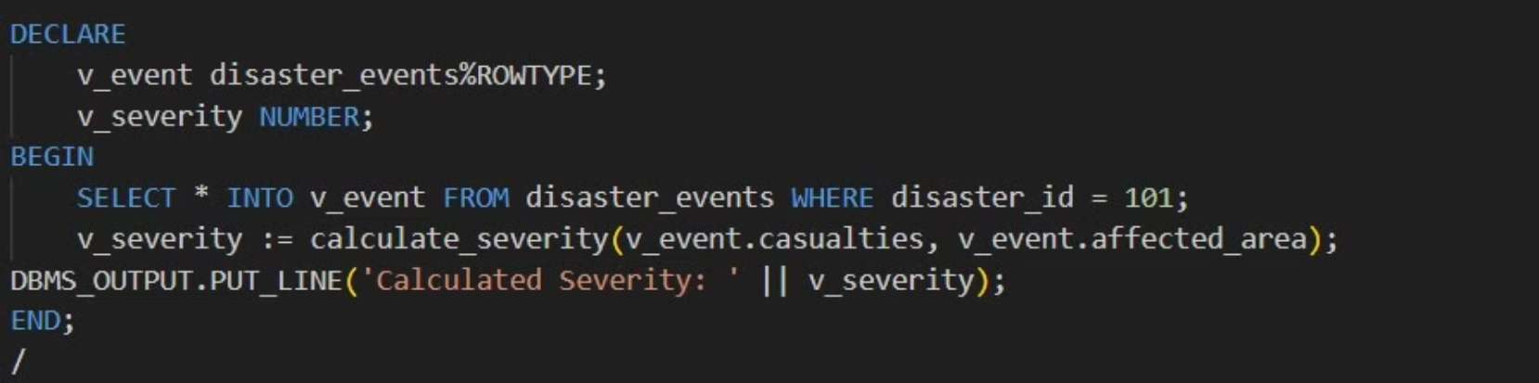
ROWTYPE

Slide 21


Challenges Faced
Addressing Key Obstacles to Enhance Collaboration and Skill Development
Unfamiliarity with GitHub
Initially, the team had limited experience with GitHub, which is a critical tool for version control and collaborative development. This lack of familiarity resulted in inefficiencies and confusion during project collaboration.
Limited Version Control Knowledge
The team's previous experience with version control systems was minimal. This gap in knowledge hindered their ability to effectively manage code changes and collaborate seamlessly.
SOLUTION IMPLEMENTED
Conducted a knowledge-sharing session on GitHub basics, including cloning repositories, committing changes, and managing pull requests. Gradually became proficient through practice.
As a result of the knowledge-sharing sessions, team members became more comfortable using GitHub. This improvement translated into better collaboration, quicker turnaround times on projects, and increased overall productivity

